Slide 1
CUSTOMER INFORMATION SYSTEM
Jogi Reddy Veluru
2320938

Slide 2
Index
Objective
Project structure
Staging area mappings
Staging area workflow
Mappings
Workflow
Transformations used
Results
Conclusion

Slide 3
OBJECTIVE
Develop an ETL process using Informatica PowerCenter with the data collected from multiple sources.
To load the data from source to target by using required transformations including mapping logics.

Slide 4
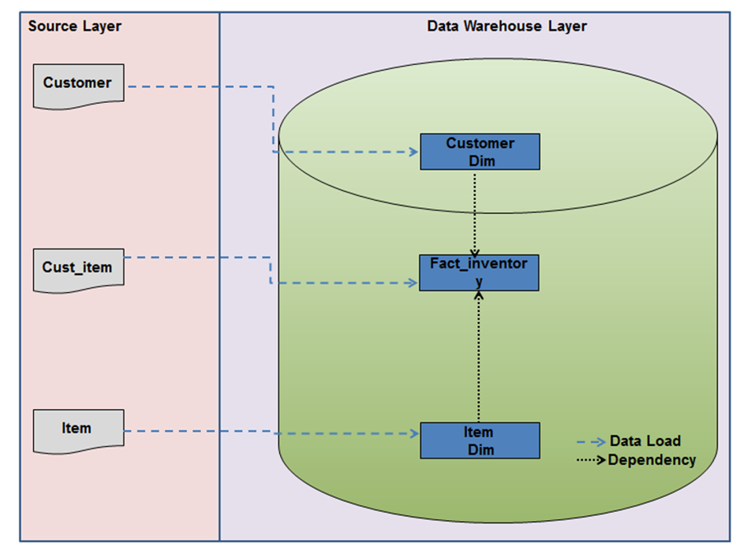
Project structure

Slide 5
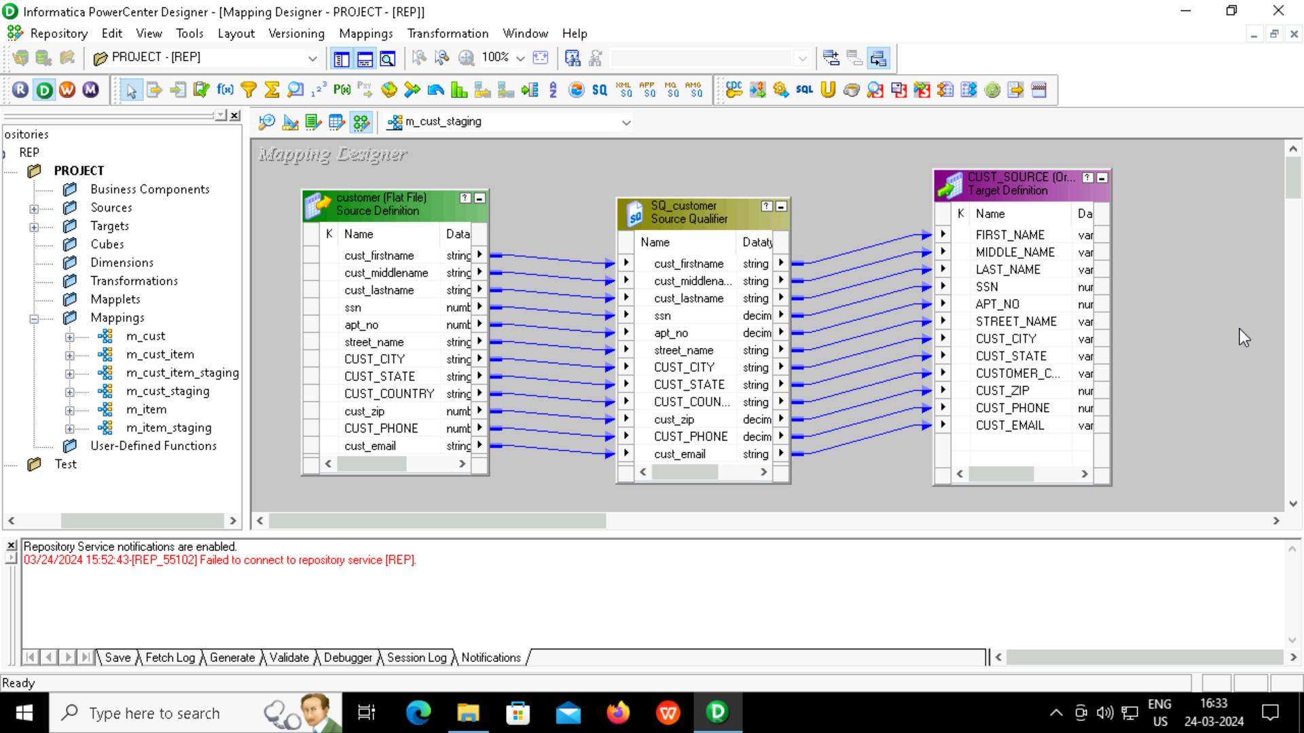
STAGING AREA MAPPING: CUSTOMER TABLE (DIM TABLE)

Slide 6
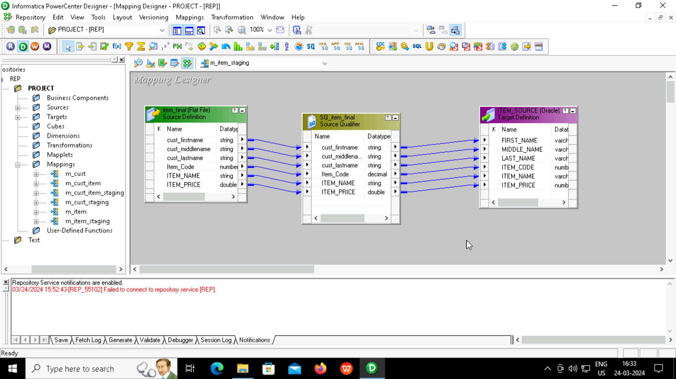
ITEM TABLE (DIM TABLE)

Slide 7
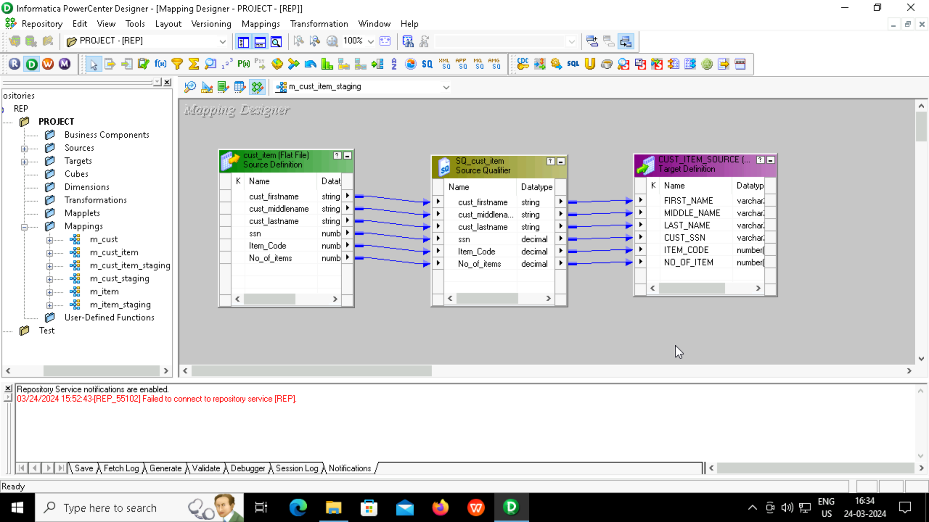
CUSTOMER_ITEM TABLE (FACT TABLE)

Slide 8
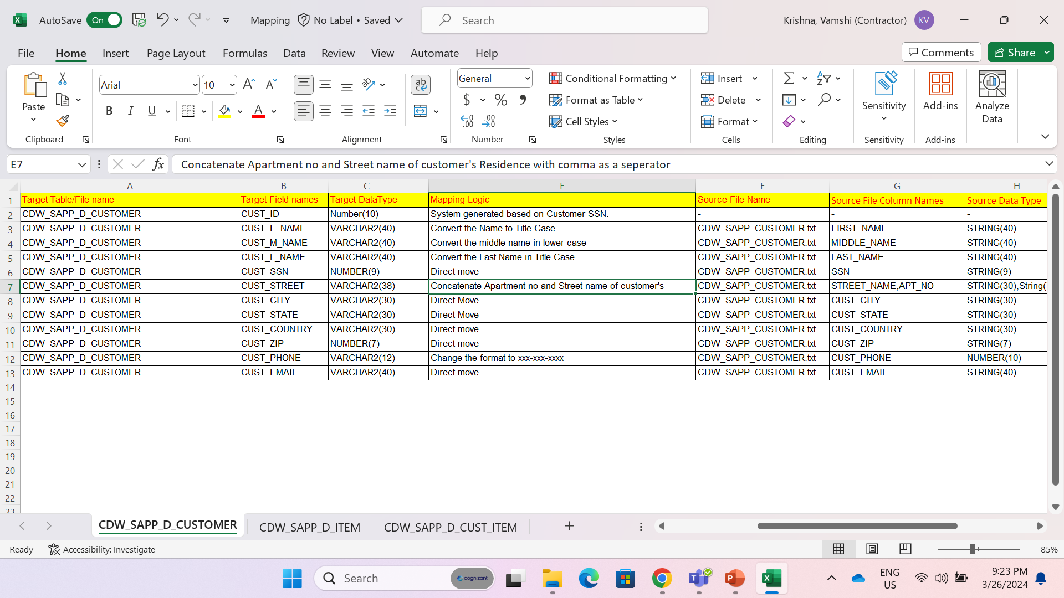
MAPPINGS Customer table mapping logic

Slide 9
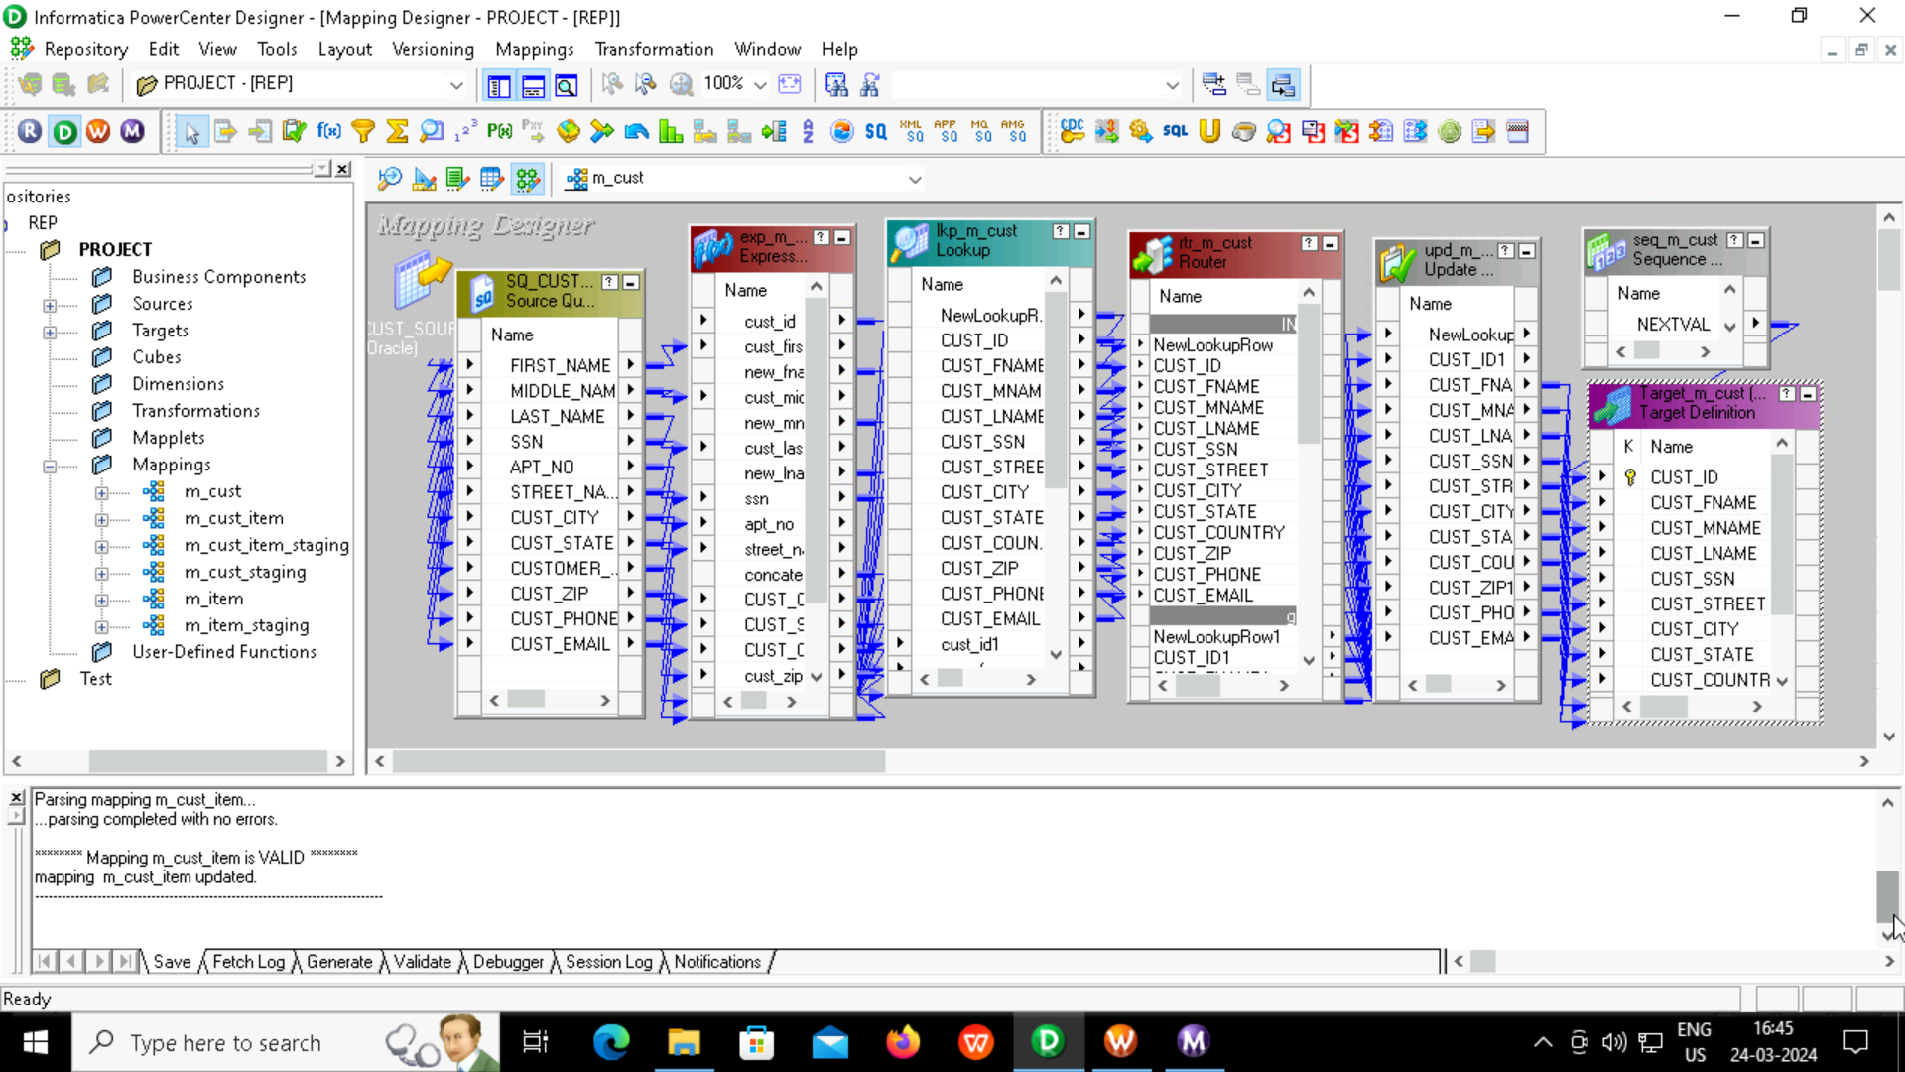
Customer table mapping

Slide 10
Customer Table
Source Qualifier
Lookup
Router
Update Strategy
Sequence generator
Expression
Transformations
used

Slide 11
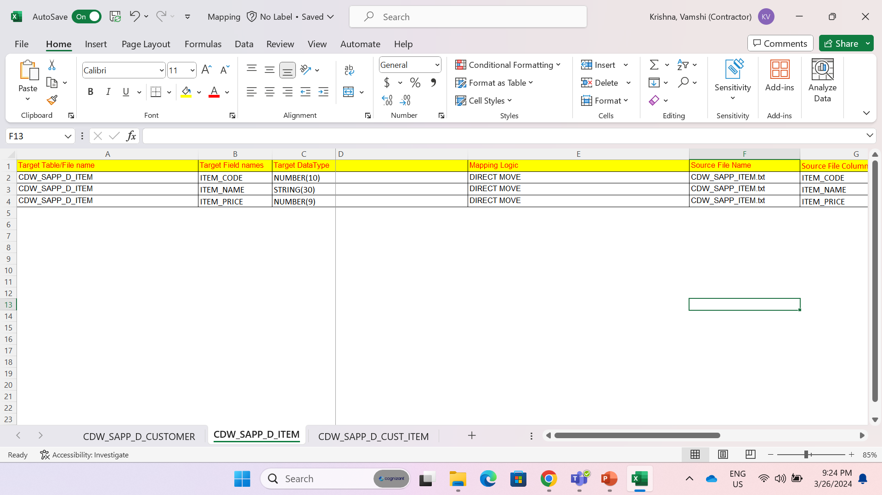
Item table mapping logic

Slide 12
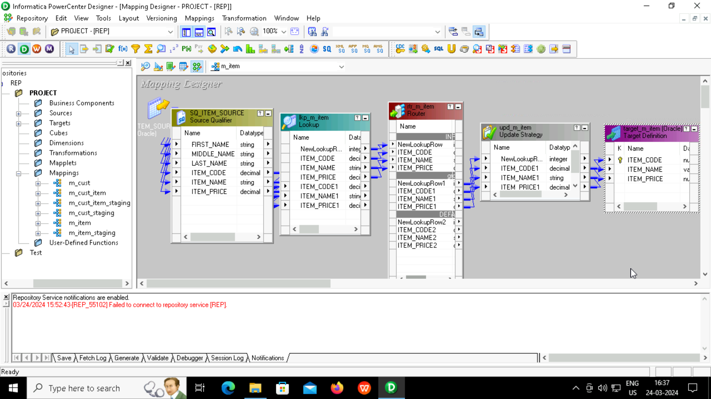
Item table mapping

Slide 13
Item table
Source Qualifier
Router
Update Strategy
Lookup
Transformations
used

Slide 14
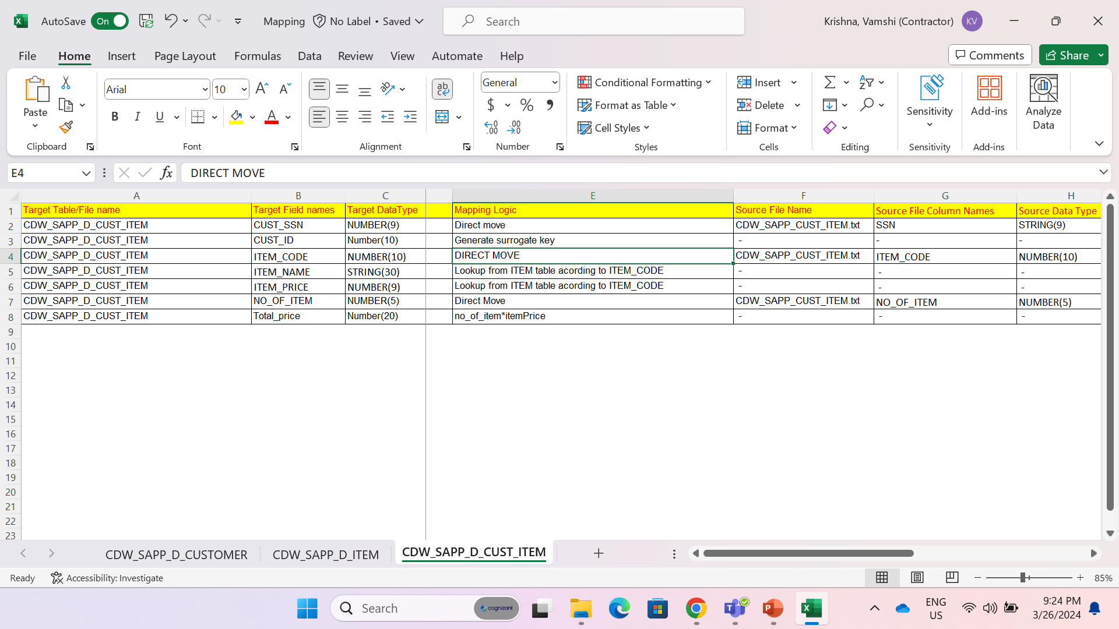
Customer_Item table mapping logic

Slide 15
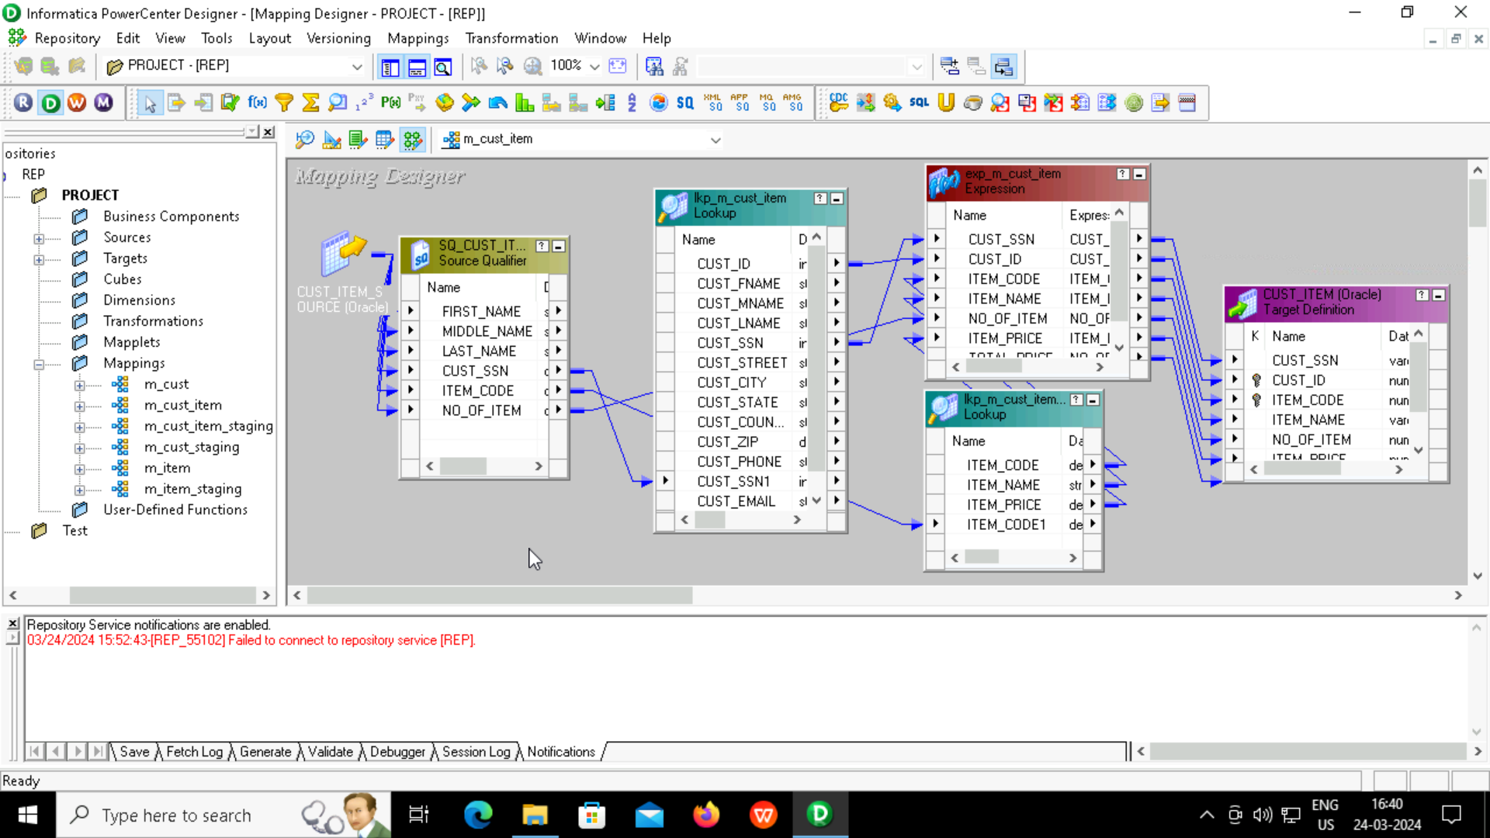
Customer_Item table mapping

Slide 16
Customer Item table
Source Qualifier
Lookup
Expression
Transformations
used

Slide 17
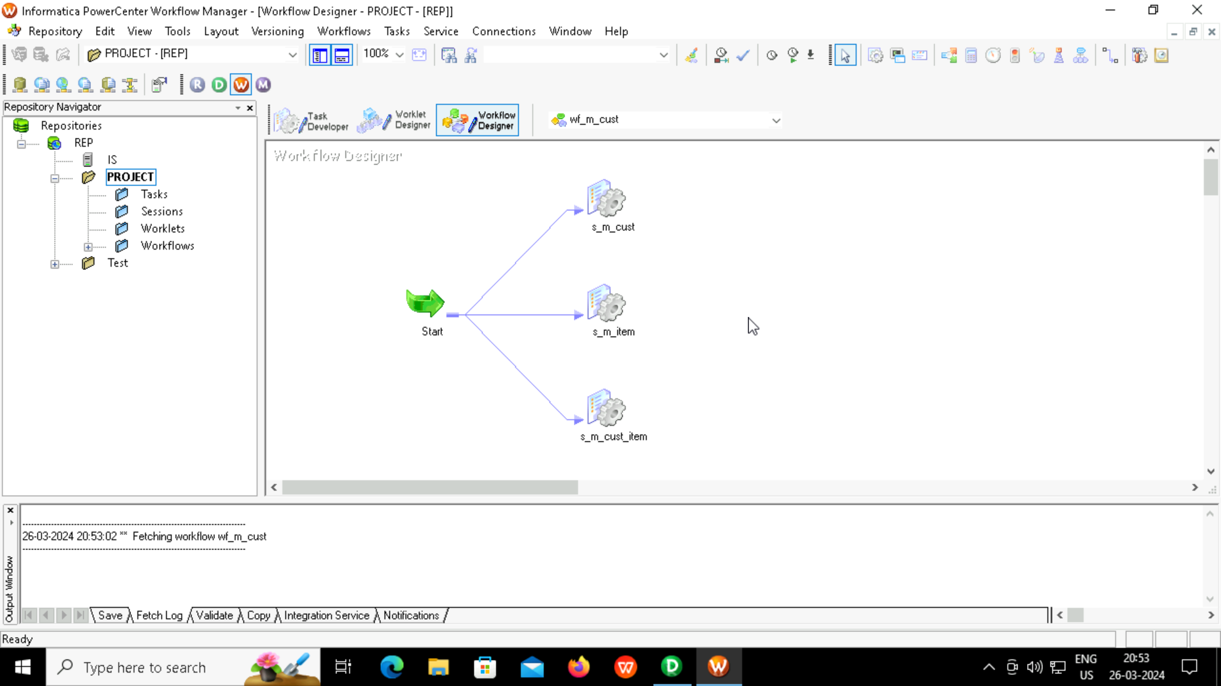
Workflow

Slide 18
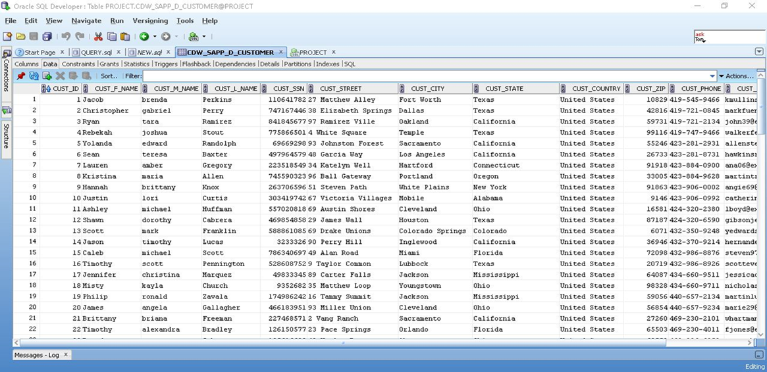
RESULTS:
Customer Table

Slide 19
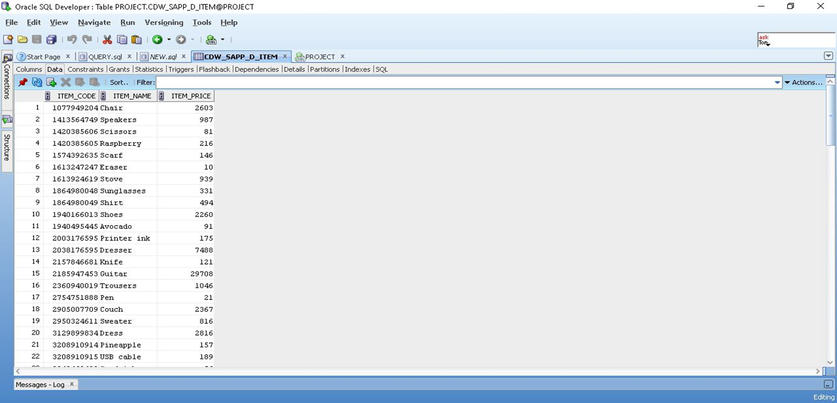
Item Table

Slide 20
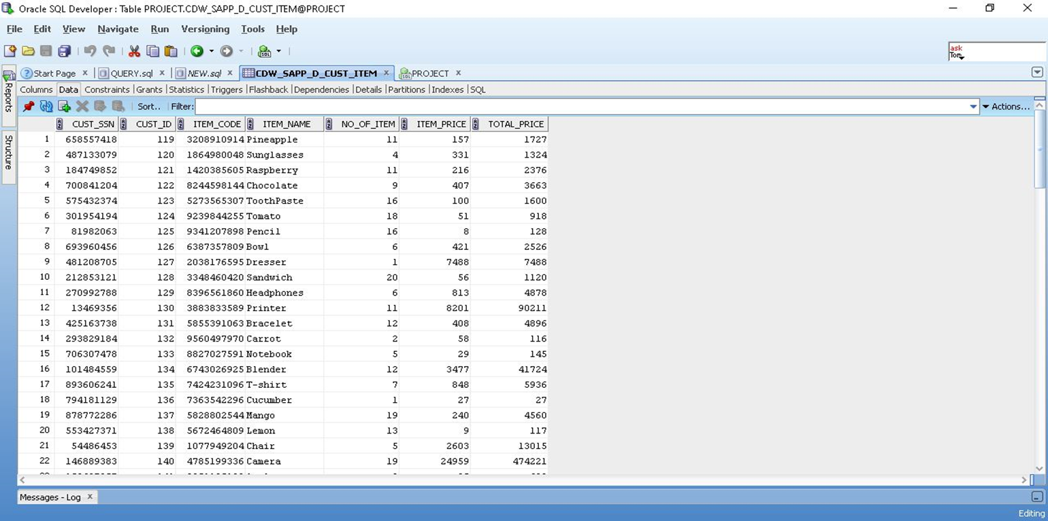
Customer_Item Table

Slide 21
THANK YOU

